Slide 1
BIOS3010 - Bioinformatics - Spring2020
Introduction to Unix
Anders K. Krabberød
a.k.krabberod@ibv.uio.no

Slide 2
Program for week 19
Introduction to UNIX and Linux
Briefly on the Unix shell, basic commands
Basic Unix exercises
Setting up your computers
Logging on to Saga!
Prepare for what’s to come – working with “big data”

Slide 3
Why learn about UNIX and Linux?
Bioinformatics tools and algorithms are very often developed for UNIX/Linux computers.
Easy to set up pipelines and automate workflows.
Powerful for handling text files, large files, and large number of files – very common in modern biology.
Able to work on High Performance Computing platforms (Supercpomputers) e.g. Saga
Access to much more computing power than from a single computer.

Slide 4
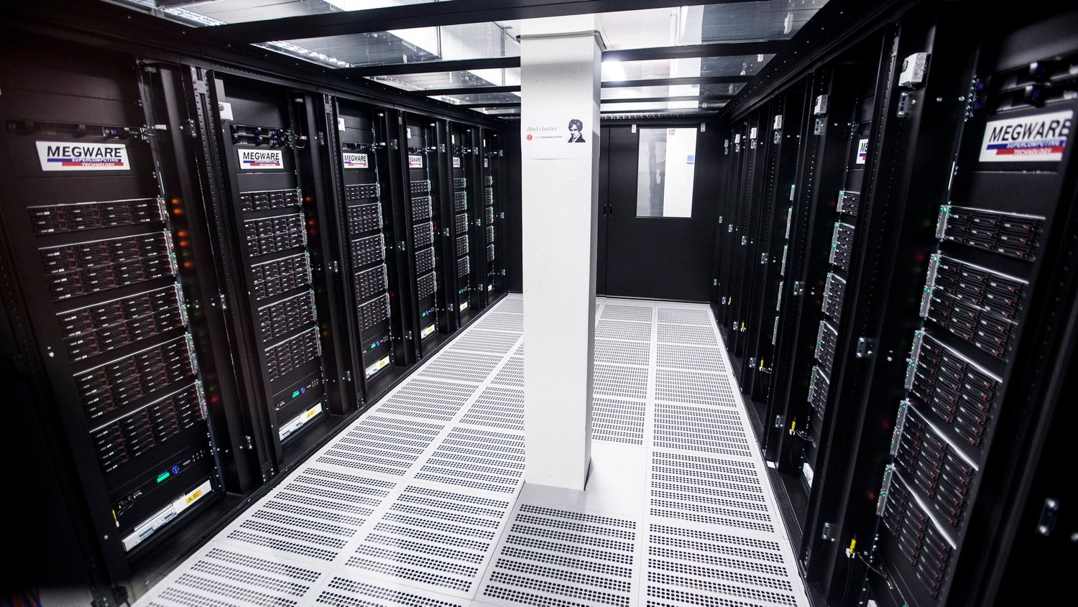
UNIX? Linux? Computer cluster? Saga???

Slide 5
HPC (High Performance Computing) cluster
One of the motivations for learning Linux is that most supercomputers or computing clusters run a version of Linux or UNIX as the OS.
Most (if not all) of the supercomputer's on the list of the top 500 most powerful computers use Linux.
MareNostrum in Barcelona. 40 000 kg of computers inside an old church. Annual cost in electricty alone is € 1.4m. www.bsc.es

Slide 6
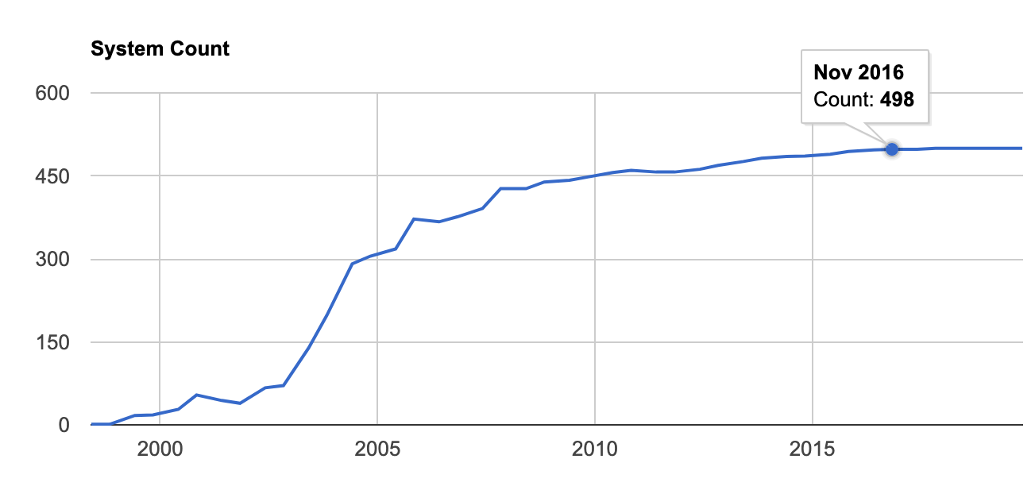
The prevalence of Linux
Linux OS on the top500 supercomputers in the world

Slide 7
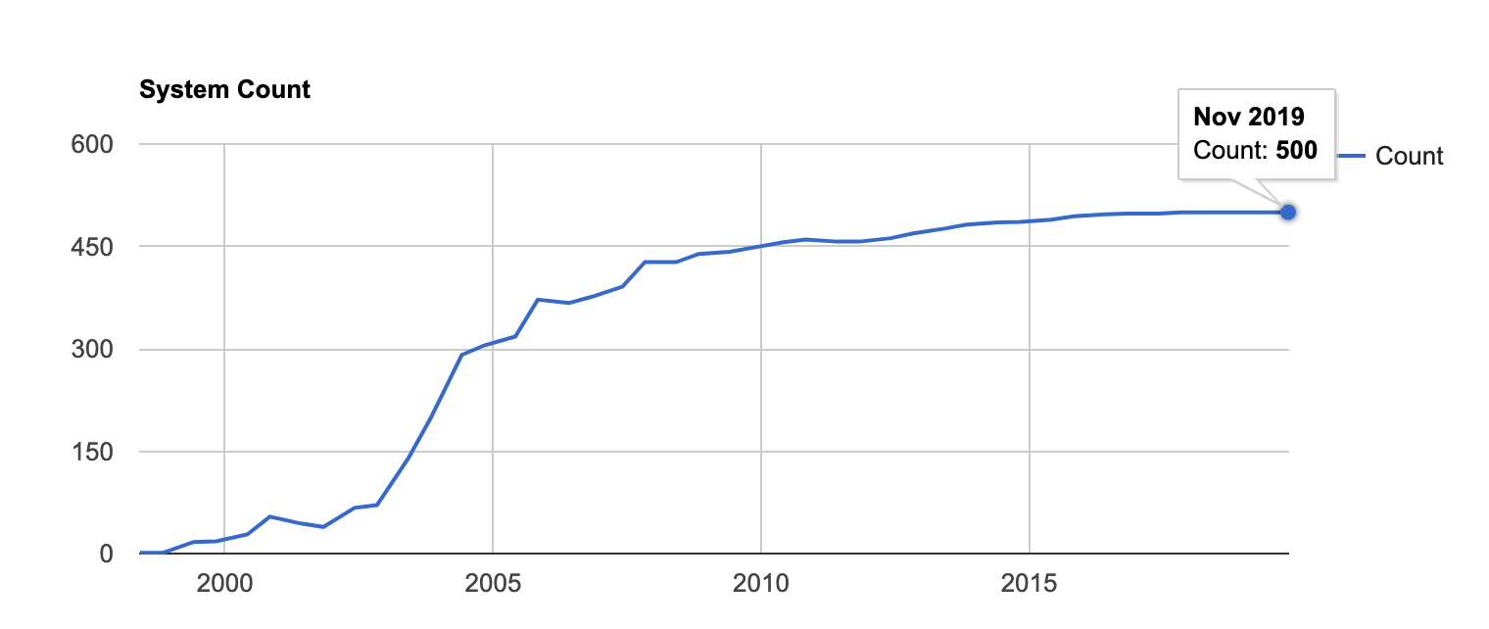
The prevalence of Linux
Linux OS on the top500 supercomputers in the world

Slide 8
HPC (High Performance Computing)
In Norway Sigma2 runs several HPC (High Performance Computing) clusters as well as other e-infrastructure facilities. https://www.sigma2.no/services-overview
Current clusters
Saga
Fram
Vilje
Stallo
Betzy (under construction)

Slide 9
Saga
Details | Saga
System | Hewlett Packard Enterprise - Apollo 2000/6500 Gen10
Number of Cores | 9824
Number of nodes | 244
Number of GPUs | 32
CPU type | Intel Xeon-Gold 6138 2.0 GHz (normal) Intel Xeon-Gold 6130 2.1 GHz (bigmem) Intel Xeon-Gold 6126 2.6 GHz (accel)
GPU type | NVIDIA P100, 16 GiB RAM (accel)
Total max floating point performance, double | 645 Teraflop/s (CPUs) + 150 Teraflop/s (GPUs)
Total memory | 75 TiB
Total NVMe+SSD local disc | 89 TiB + 60 TiB
Total parallel filesystem capacity | 1 PB
We will use Saga for this course
Online as of fall 2019
A computing cluster with 200 standard compute nodes, with 40 cores and 192 GiB memory each,
Total 9824 cores
Access to resources is managed with a queue system: SLURM
OS on Saga Linux

Slide 10
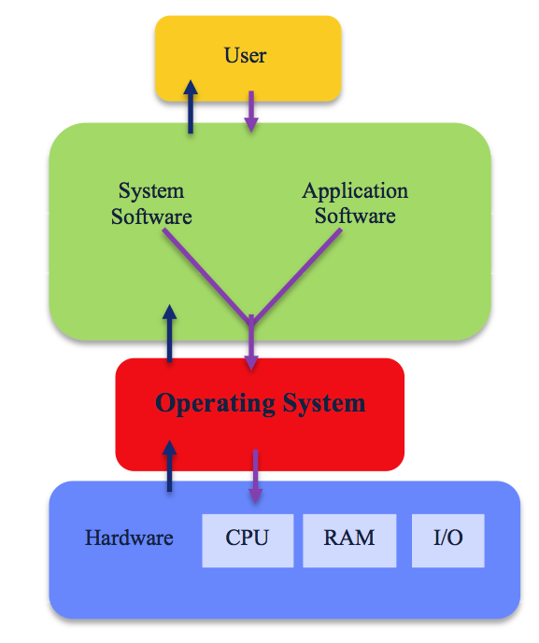
Operating systems (OS)
Software that manages computer hardware
input from keyboard and pointing devices.
output to screen (or file).
keeps track of, reads and writes files.
Provides common services for computer programs

Slide 11
UNIX: the mother of (almost) all OS
UNIX was Initially developed in 1969 (Bell Labs / AT&T)
Coded mostly in C (also developed by AT&T)
Multi-tasking (resources are shared)
Multiuser (can handle many users simultaneously)
KenThompson and Dennis Ritchie, two of the UNIX developers

Slide 12
The UNIX philosophy
The success of the UNIX framework is because of the philosophy behind the development
Write programs that do one thing and do it well.
Write programs that will work together.
Write programs to handle text streams, because that is a universal interface.

Slide 13

Demystifying files
Many files used in bioinformatics are just text files.
Extension given to the file reflects the format, or how the “internal layout” of that file is.
Often the format is formulated as set of rules that tells the user what the file should contain and how it should be organised
>Seq1
ATGGTATGACCATGT
>Seq2
ATGGTGGCTTGCTG

Slide 14
Demystifying files - examples
Fasta
Lines starting with > is the sequence identifier
Lines that follow without > is the sequence (DNA, RNA or Amino Acids)
Fastq -
Sequence with quality score
4 lines per sequecnce
Line 1 begins with a '@' followed by header
Line 2 is the sequence
Line 3 begins with a '+' and is optionally followed by the sequence identifier and description
Line 4 encodes the quality values for the sequence in Line 2, and must contain the same number of symbols as letters in the sequence.
>First_sequence_id
ATGGTATGACCATGT
>Next_sequence_id
ATGGTGGCTTGCTGGGCCGGGT
@First_sequence_id
ATGGTATGACCATGT
+
!''*((((***+))%1
@Next_sequence_id
ATGGTGGCTTGCTGGGCCGGGT
+
%%).1***-+*''))**55)KM

Slide 15
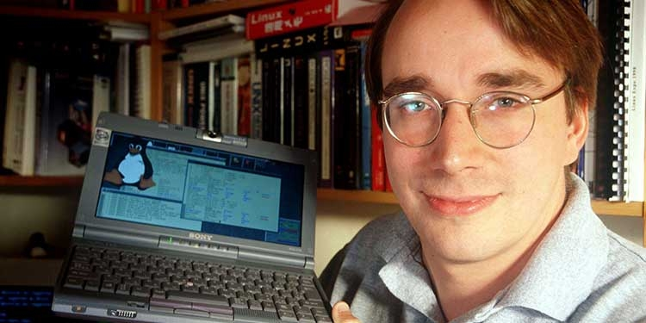

Linux
Development started by Linus Torvalds in 1991
UNIX clone
Free and open Source
Now comes in many variants
Ubuntu
Debian
Centos
++++++
Some variants are portable enough to be installed on a usb pendrive.
Linus Torvalds with the first Linux kernel in 1991

Slide 16
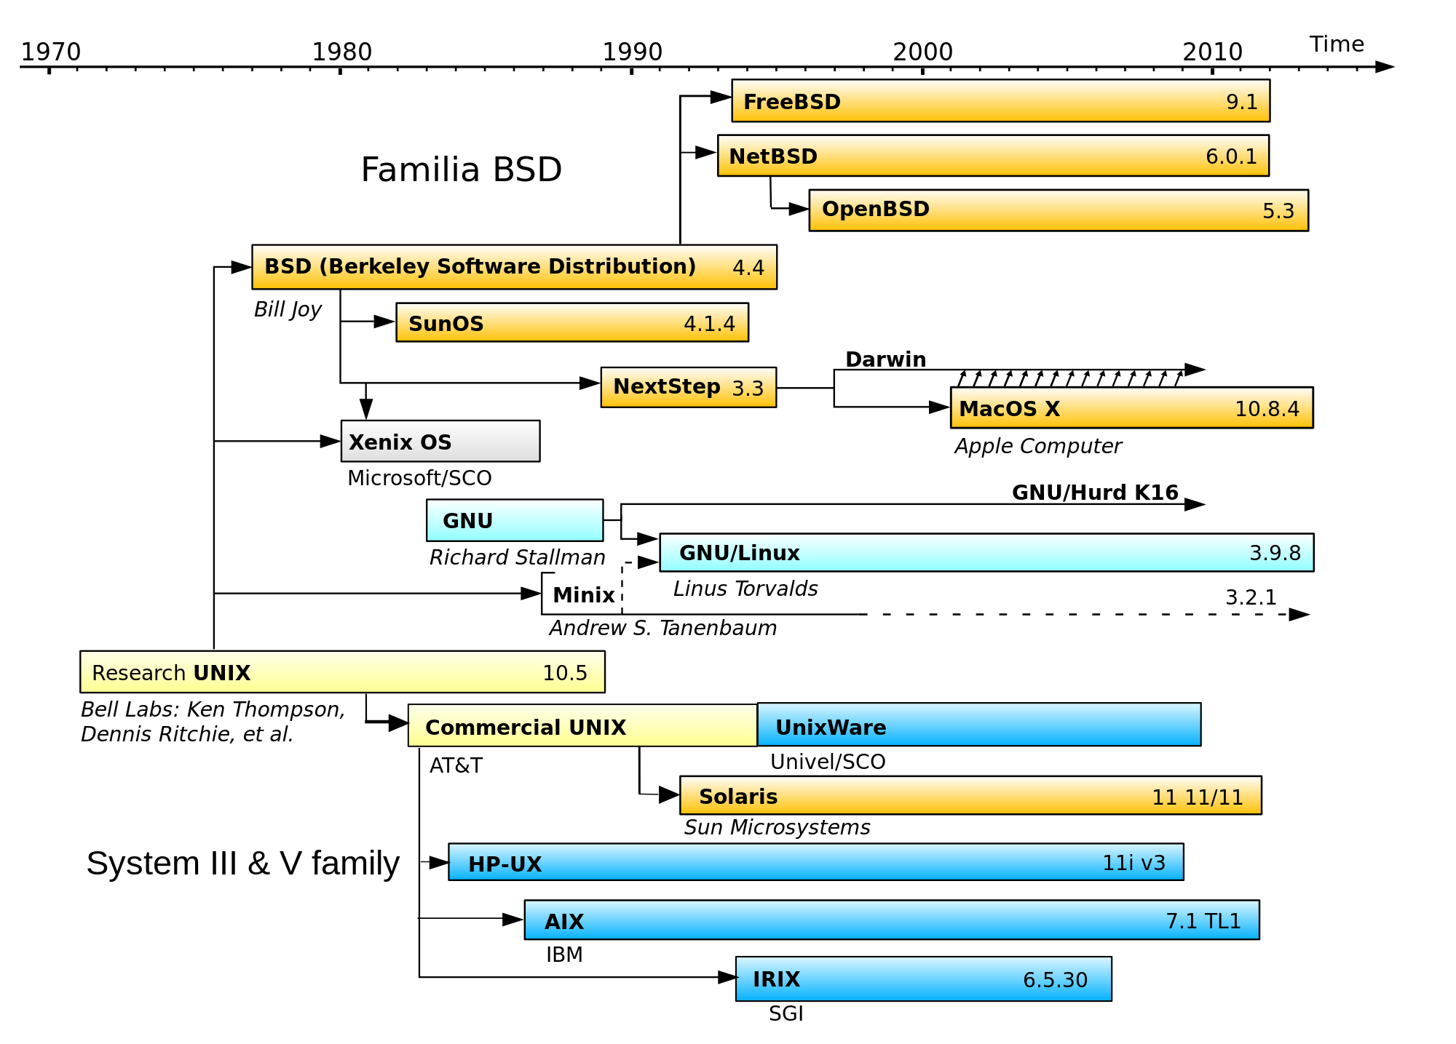
Timeline of UNIX/ Linux development
For more about the relation between UNIX and Linux: https://youtu.be/jowCUo_UGts

Slide 17
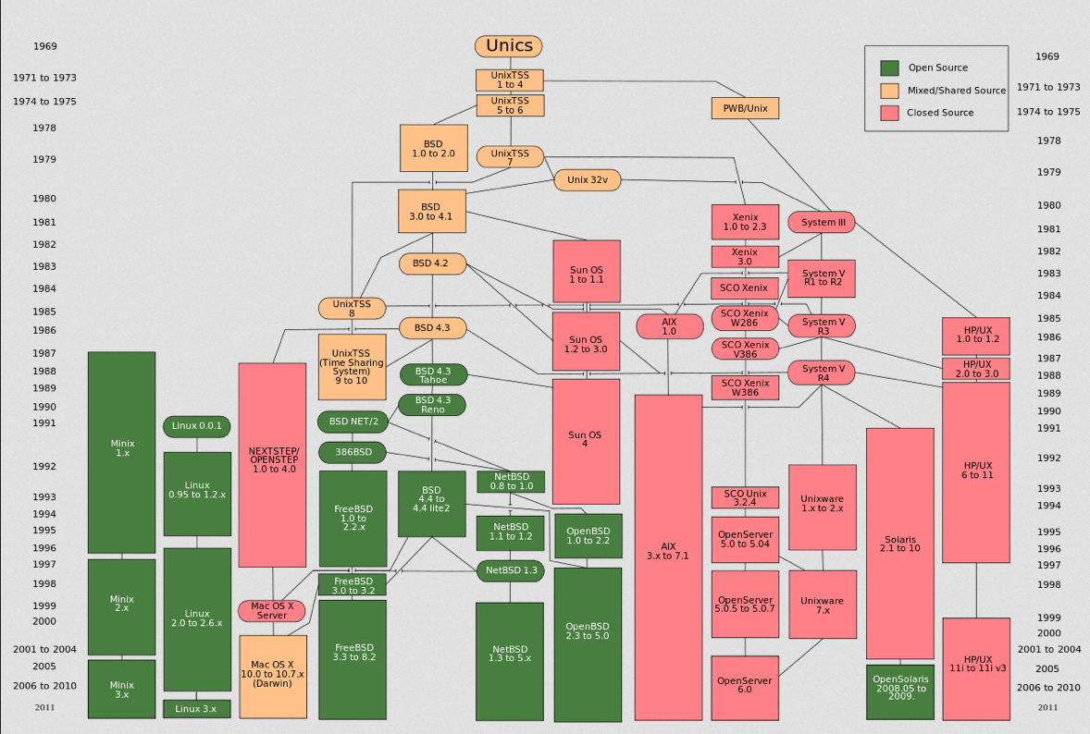

Slide 18
Advantages with Linux
Stability
Security
Good control of users and processes
Can handle large computing load
Open Source (you can see and modify the code)
Several free options (Ubuntu, CentOS, Debian, etc.)
Large community of developers
Large amount of free software (specially for bioinfo)
Disadvantages
Some hardware may not be supported
Can be less user friendly than other options
(For CLI) It’s not point-and-click

Slide 19
The prevalence of UNIX and Linux
Android phones runs Linux
The MacOS is based on a UNIX clone
The iOS on iPhones is also based un UNIX
The World Wide Web is basically a network of Linux-server
Windows computers do not use UNIX

Slide 20
Poll
What kind of computer do you use?
What kind of OS du you run?
Windows
Mac
Linux?
Have you used Linux before?

Slide 21
Terminology - recap
UNIX is the original OS
Linux is not UNIX, but it is based on the same underlying philosophy (more on this later).
GNU is not UNIX
which incidentally is the intention of the acronym GNU: GNU is a recursive acronym for “GNU's Not Unix
A shell is an access interface for the operating system. It is a program used for controlling and running programs.
Bash is a shell program (others include sh, ash, zsh, ksh…)
A terminal is a program that lets the user interact with the shell. It interprets the keystrokes from the user and passes it on to the shell.
A kernel is the central part of an operating system. It manages the operations of the computer and the hardware, most notably memory and CPU time
POSIX stands for Portable Operating System Interface, and is an attempt by a consortium of vendors to create a single standard version of UNIX

Slide 22
Questions?

Slide 23
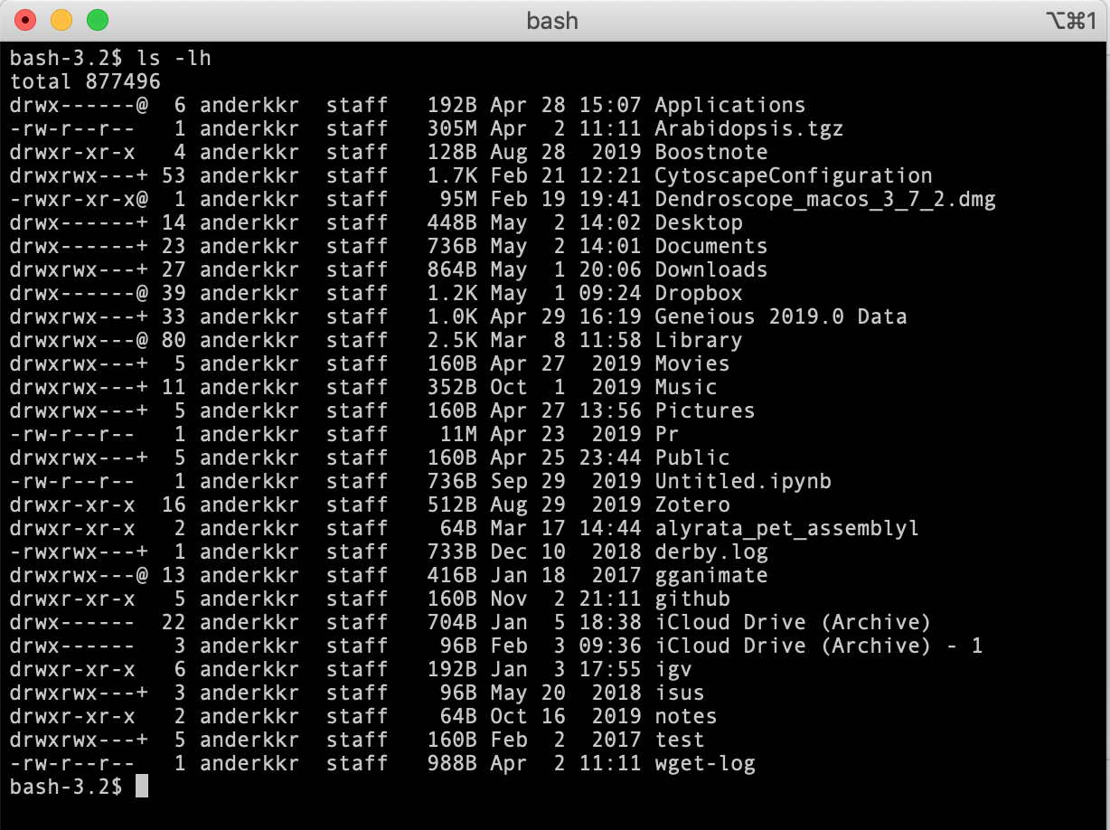
UNIX is text based
You need a way to communicate with the OS
A terminal will interpret your kesytrokes
A shell interprets the commands

Slide 24
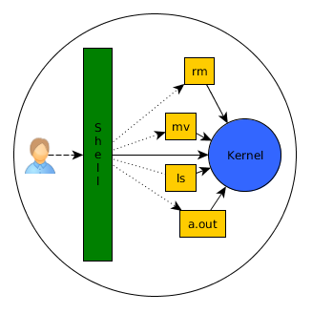
The Shell
The shell is a user interface that provides access to the operating systems services.
It is called a shell because it is the outermost layer around the operating system.
Generally comes in two flavours:
Command-line interface (CLI)
Graphical user interface (GUI)

Slide 25
Command-line interface (CLI) shell
You type in the commands and press enter. The shell figures out how to interpret the commands and which programs to run.
The shell is the user interface for communicating with the computer. There are many different kinds of shells and I won’t go into detail about this. And for most basic use they will do mostly the same. But the most popular Shell is the Bash (Bourne again shell). It is default on most Linux implementations today.

Slide 26
The Shell
The user writes commands on the command line usually in a terminal window
Line-by-line
Step-by-step
Logical work flow
Linux is case-sensitive!

Slide 27
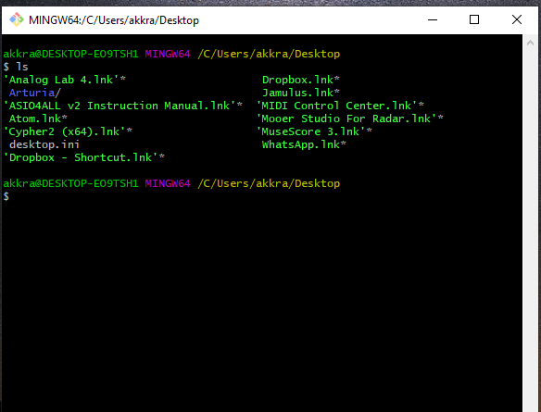
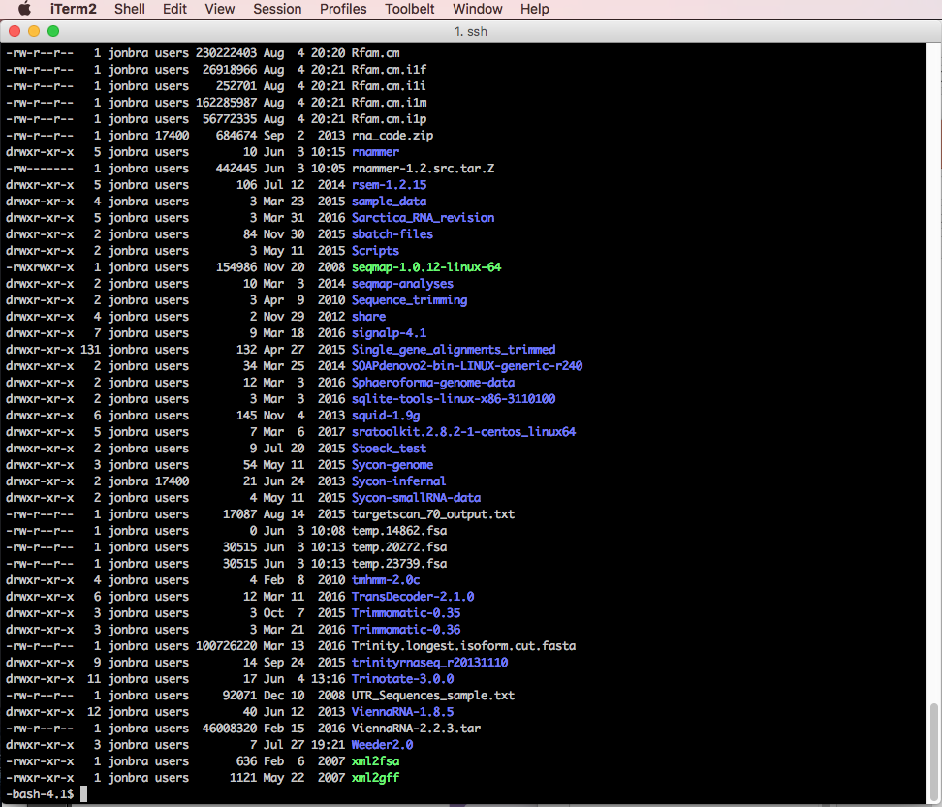
The Shell
The Bash shell is default on most Linux implementations.
Bourne-again shell

Slide 28
The Shell
Getting a shell
Windows: Gitbash for windows (https://gitforwindows.org/),
click download, scroll down and choose the latest 64-bit .exe file. Install then start gitbash from the start menu.
Other options for shell exists and if you have something you are comfortable with using already installed, that is fine.
Mac and Linux: A shell is already installed (launch the Terminal application).

Slide 29
If you’ve never used the terminal, you can start with simple commands and a good amount of patience ☺
There’s plenty of resources and documentation online
Goolge is you friend!
A set of instructions and exercises made for the course will help you:
https://github.com/krabberod/bios3010-unix-linux

Slide 30
Poll
Have you used a terminal/shell/command line before?
Do you know how to log on to a server?

Slide 31
Coffee break!

Slide 32
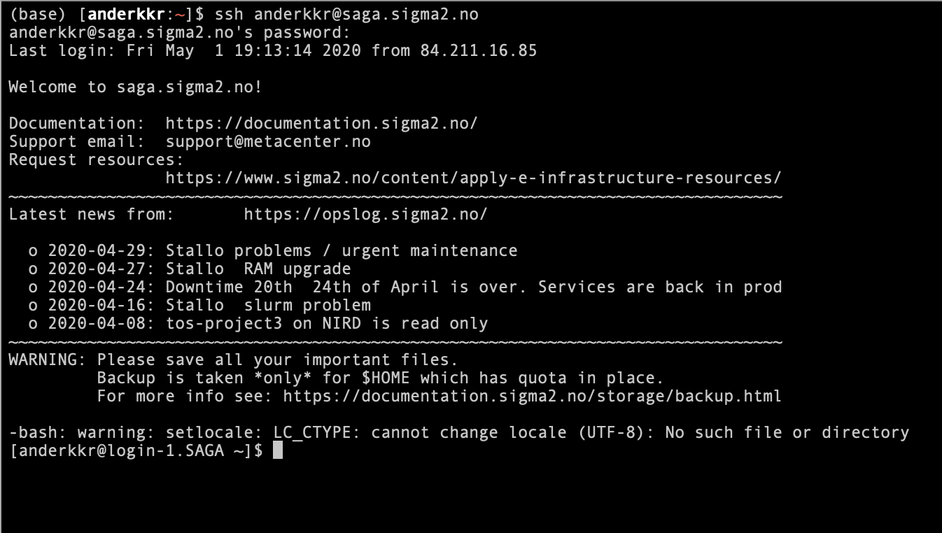
Login into Saga
Open terminal (mac/linux) or start gitbash (windows)
Type ssh <username>@saga.sigma2.no
Type password

Slide 33
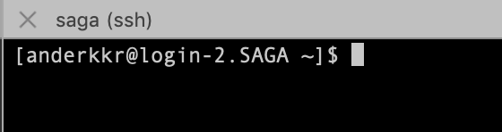
The dollar sign is a prompt, shows that the shell is waiting for input.
The cursor. This is where you write commands

Slide 34
General comments on commands
The commands operates on text. Either files containing text or input from the keyboard (called standard input).
Commands in Linux usually takes the form
command [-options] inputfile
The philosophy of Linux (and UNIX) programs is that they are supposed to be simple and efficient with a standardised way of taking inputs and giving outputs. Because of the standardisation, the output of one command can (often) be used as the input of another command. The advantage of this will be clear later.
The full manual for a command can be accessed with man command

Slide 35
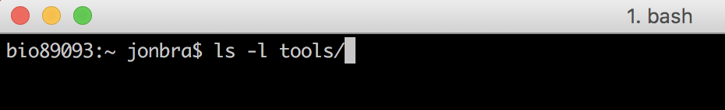
Unix command syntax
command [-option(s)] [argument(s)]
There must be spaces between commands, options and arguments
command
option
argument

Slide 36
Remote login program (ssh)
man ssh
ssh (SSH client) is a program for logging into a remote machine and for
executing commands on a remote machine. It is intended to provide secure
encrypted communications between two untrusted hosts over an insecure
network. X11 connections, arbitrary TCP ports and UNIX-domain sockets
can also be forwarded over the secure channel.
ssh connects and logs into the specified destination, which may be speci-
fied as either [user@]hostname or a URI of the form
ssh://[user@]hostname[:port].

Slide 37
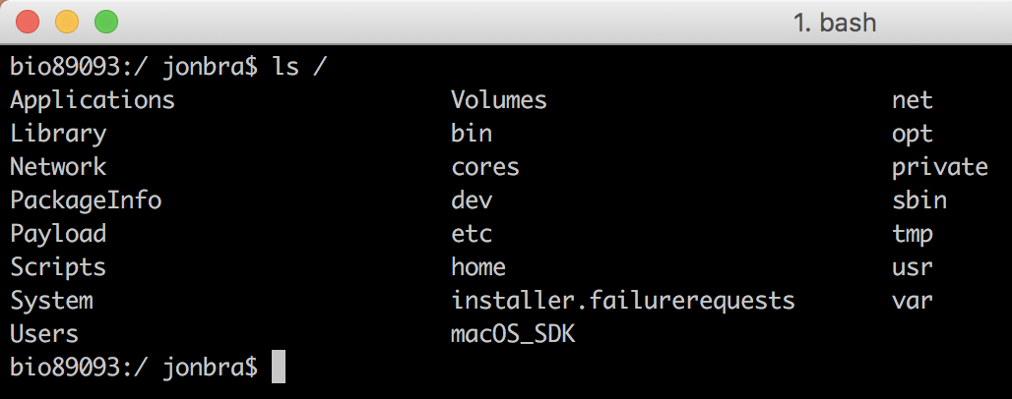
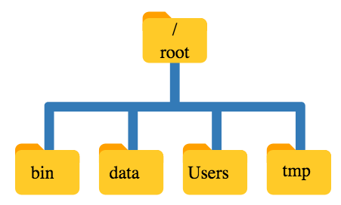
File structure
Unix has a hierarchical file system.
At the top is the root directory that holds everything else. We refer to it using a slash character / on its own
Inside that directory are several other directories:
bin (which is where some built-in programs are stored),
data (for miscellaneous data files),
Users (where users’ personal directories are located),
/(root)
bin
data
Users
tmp

Slide 38
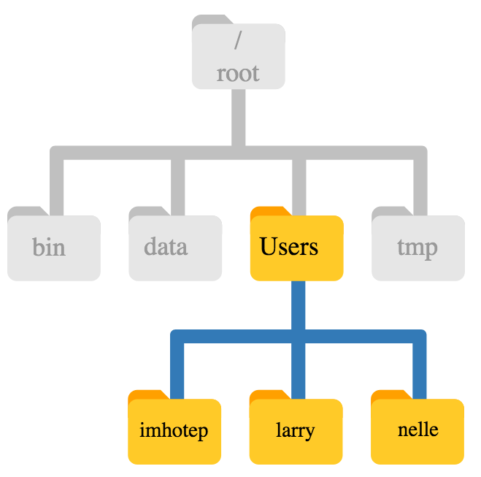
File structure
/(root)
bin
data
Users
tmp
larry
jonbra
susi

Slide 39
File structure
The home directory path may look different depending on the OS.
E.g. Windows MS-DOS: C:\Documents\jonbra or C:\Users\jonbra
Mac/Linux/gitbash: /Users/jonbra (or something similar)
/(root)
This is usually your home directory (if you are the user jonbra)
bin
data
Users
tmp
larry
jonbra
susi

Slide 40
File structure
/(root)
The home directory is also ~/ or $HOME
“tilde” character!
bin
data
Users
tmp
If you are logged in as jonbra, ~/jonbra will also be your home directory
(~/)
larry
~/jonbra
susi
Notes:
In Unix ”tilde” represents the Home directory.

Slide 41
Navigating the filesystem
cd changes directory
ls lists the files and directories in the current directory
pwd prints the path of the current directory
~/ or $HOME is your home directory (cd will take you there)
. is your current directory
.. is the directory directly above the current
http://swcarpentry.github.io/shell-novice

Slide 42
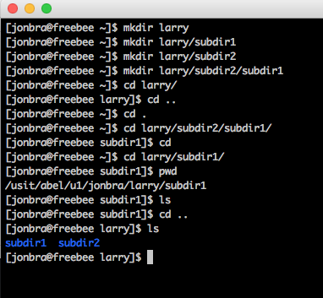
To make a new directory: mkdir
mkdir larry
To make subdirectories
mkdir larry/subdir1
mkdir larry/subdir2
mkdir larry/subdir2/subdir1
To navigate use cd (change directory)
cd larry
cd .. (takes you one level up)
cd . (you stay where you are)
cd (shortcut directly to your home directory)
To find out where you are, use pwd (print working directory)
To list the files and directories in the current directory use ls
/
root
bin
data
Users
tmp
larry
jonbra
susi
subdir1
subdir2
.
.
.

Slide 43
Transfer files
You will learn to transfer files between Saga and your laptop (both ways) in the exercises
We will use the command line with scp
You can use software such as
WinSCP (for windows)
Fetch (Mac)
Cyberduck (Mac)

Slide 44
Transfer files with scp
scp is used to copy files from one machine to a remote machine over a secure SSH connection.
General structure:
scp <from> <to>
Example a files sent to saga:
scp file.fasta username@saga.sigma2.no:/cluster/home/username/
command
file to be sent
where to send it username@location:path

Slide 45
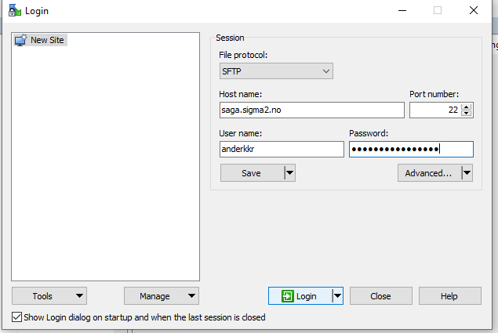
Transfer files WINScp
Windows users only:
WinSCP https://winscp.net/eng/download.php
host = saga.sigma2.no

Slide 46
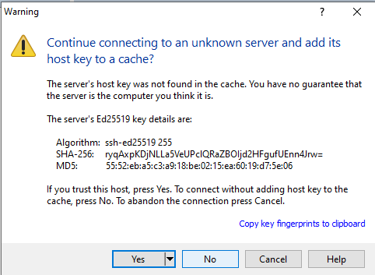
Transfer files WINScp
Press “yes”

Slide 47
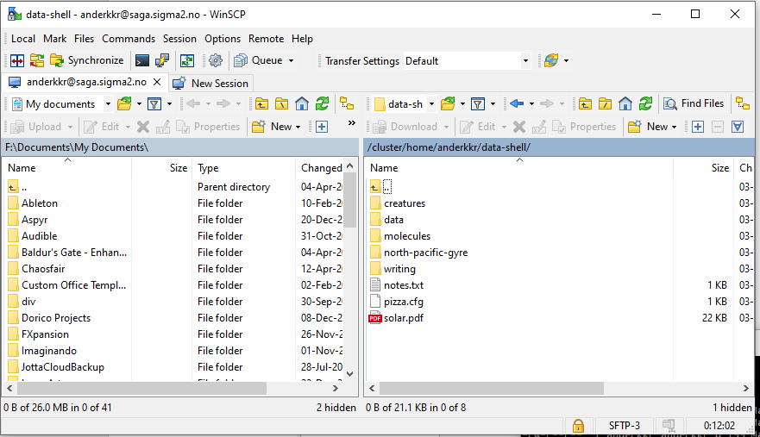
Transfer files WINScp
Your computer!
Saga!

Slide 48
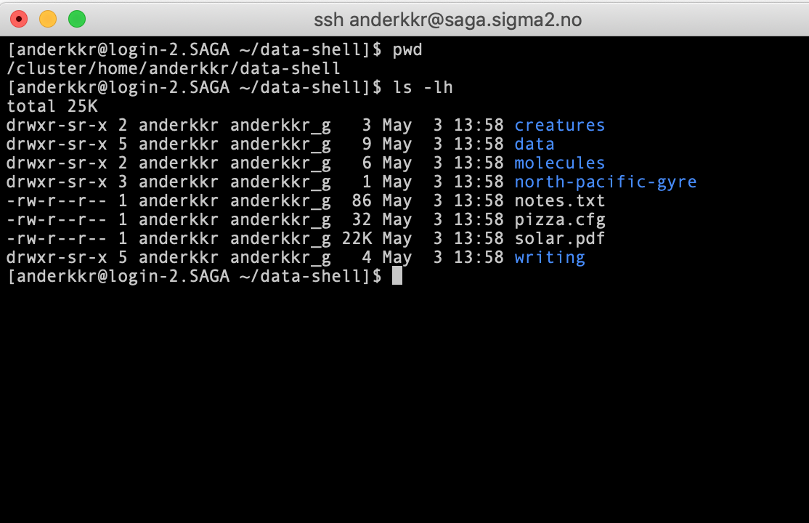
Transfer files WINScp
Your computer!
Saga!

Slide 49
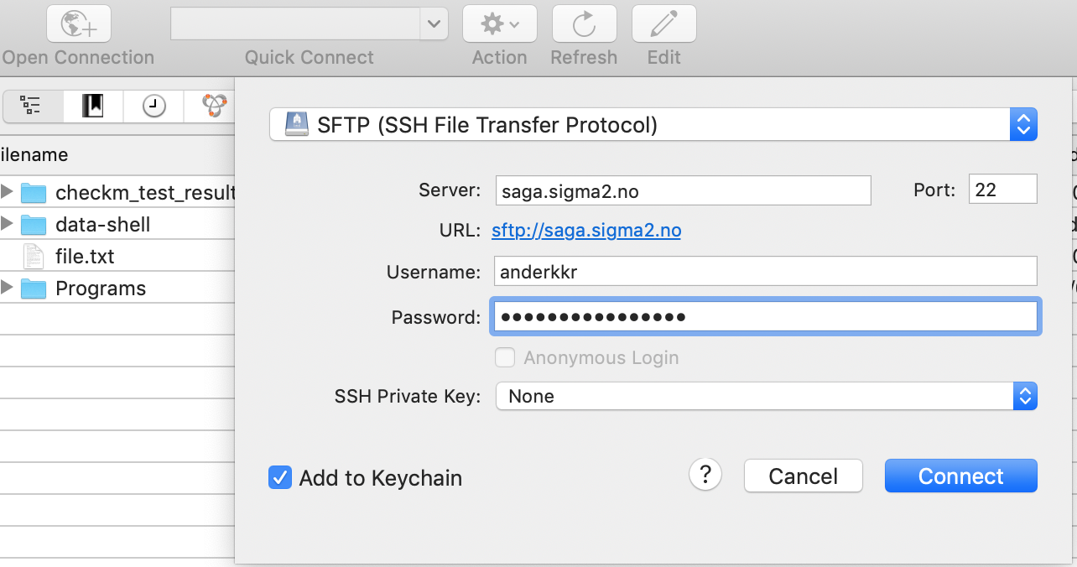
Transfer files with Cyberduck (Mac)
https://cyberduck.io/
Download, unzip and open Cyberduck
Click Open Connection
Choose SFTP (SSH File Transfer Protcol)
Enter servername
saga.sigma2.no
Enter username and password
Click connect

Slide 50
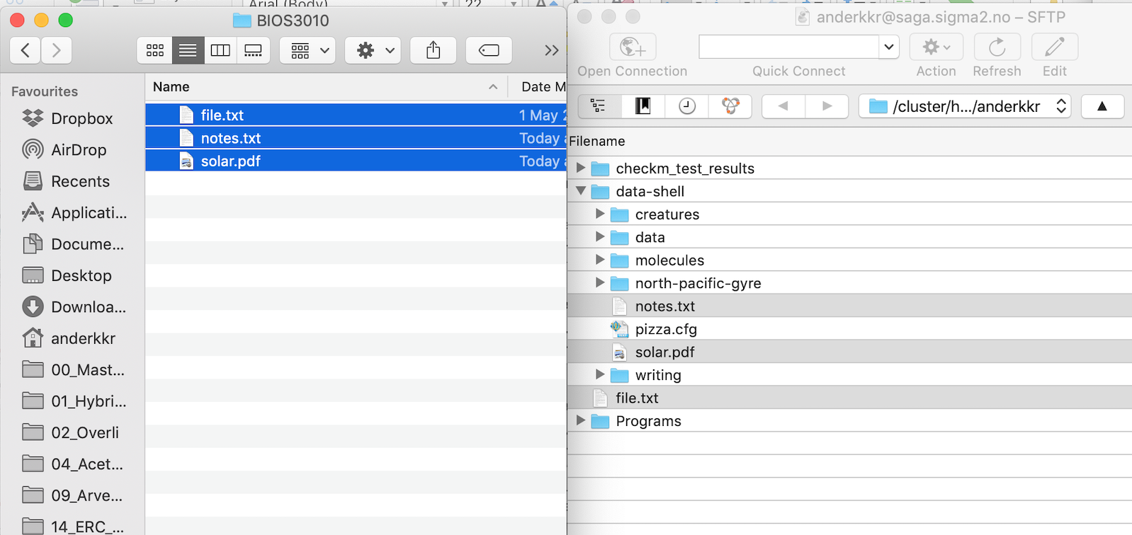
Transfer files with Cyberduck (Mac)
Now you can drag-and-drop files between the Cyberduck window (Saga) and a finder window (your computer)
Local computer
(Finder window)
Saga
Cyberduck

Slide 51
Some of the most useful commands which will be covered in the exercises
ssh - Secure log on
ls - List content
pwd - Print the working directory
cd - change directory
mkdir - make directory
cp - Copy files and directories
scp - Secure copying of files and directories
rsync - Synchronise and transfer files and directories
rm -Remove files and directories
less - Print content of file to screen
more - Print content of file to screen
head - Print the head of file(s)
tail - Print the end (tail) of file(s)
cat - Print and concatenate several files
grep - Search through text files
sort - Sort the content of files
uniq - Print unique (lines, or words)
Special operators:
> (IO redirection)
>> (IO append)
| (the vertical line is called pipe)
Useful cheat sheet: https://cheatography.com/davechild/cheat-sheets/linux-command-line/

Slide 52
Remember
Linux commands are case sensitive!
ssh
is NOT the same as
Ssh
Filenames and paths are also case sensitive!
huge_file.fasta
is NOT the same as:
Huge_file.fasta
Protip: Use the tab-key to autocomplete

Slide 53
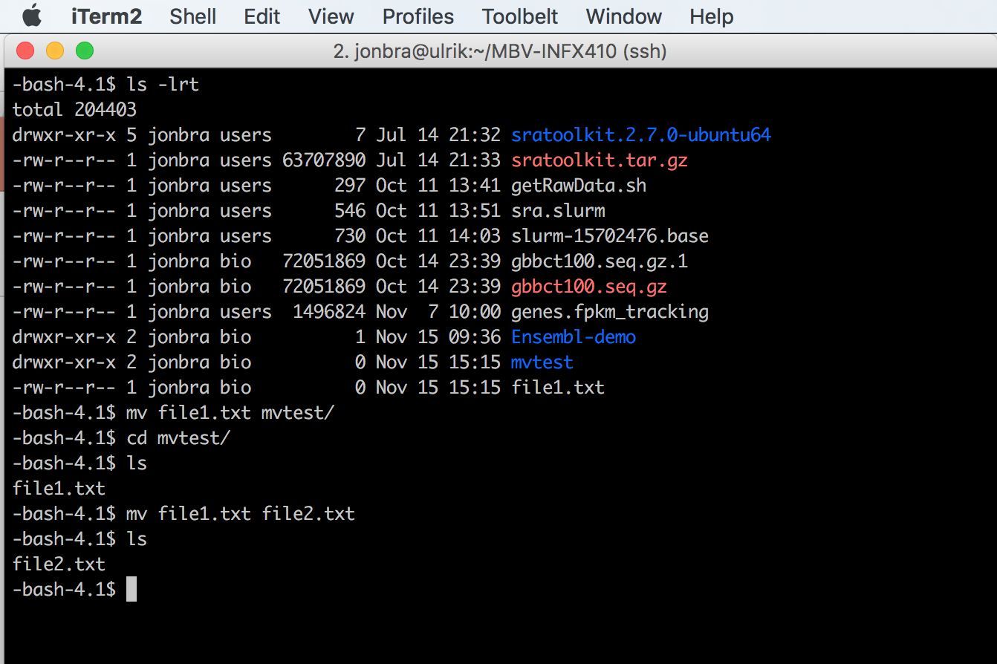
Moving files with the mv command
Move file1.txt to directory mvtest
Pro tip:
mv command can also rename files!
(“moves” file to a new filename)
Notes:
Gjøre disse tingene live

Slide 54
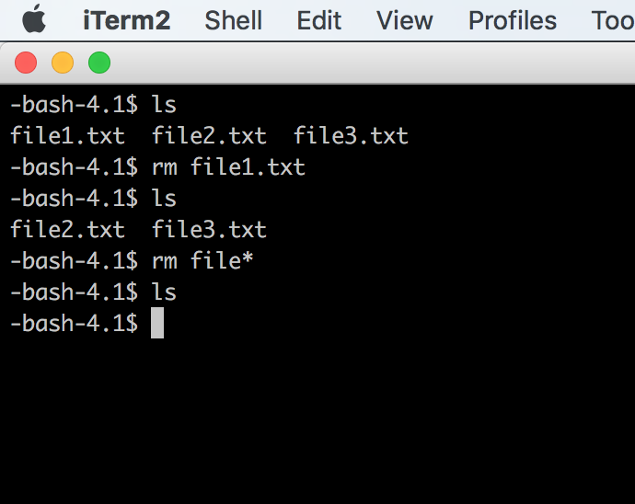
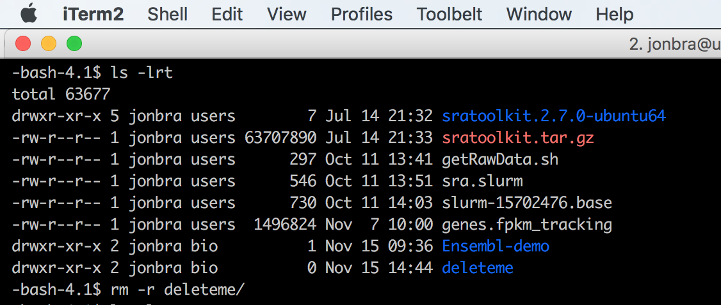
Delete files with the rm command
Delete empty directories with rm –r
Delete directories AND
files within with rm –rf Use with caution!! (rm –i)
NB! There’s no trash can on Unix!
Your files are immediately deleted!

Slide 55
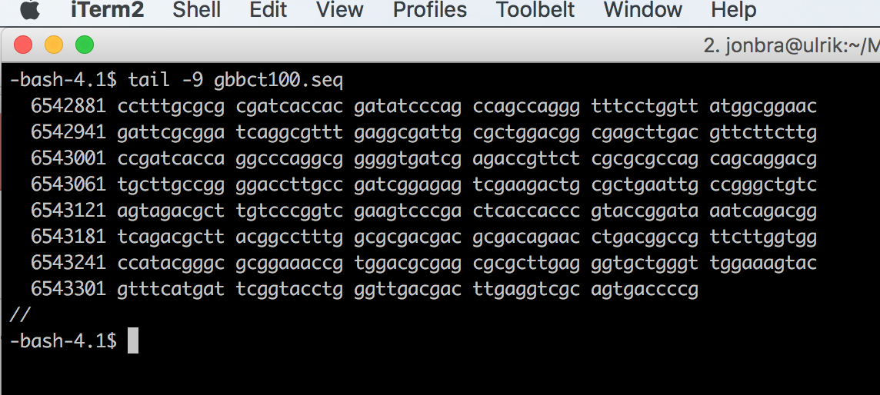
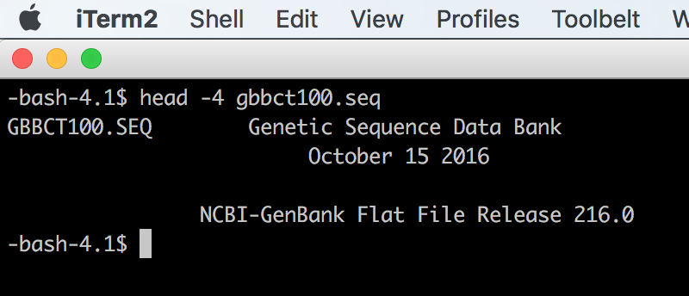
Viewing files
Pro tip:
Use the different
options to tweak the output
cat displays the entire content on the screen
less displays the content on the screen one file/line at a time (press ”q” to exit).
head/tail displays the first or last lines of a file

Slide 56
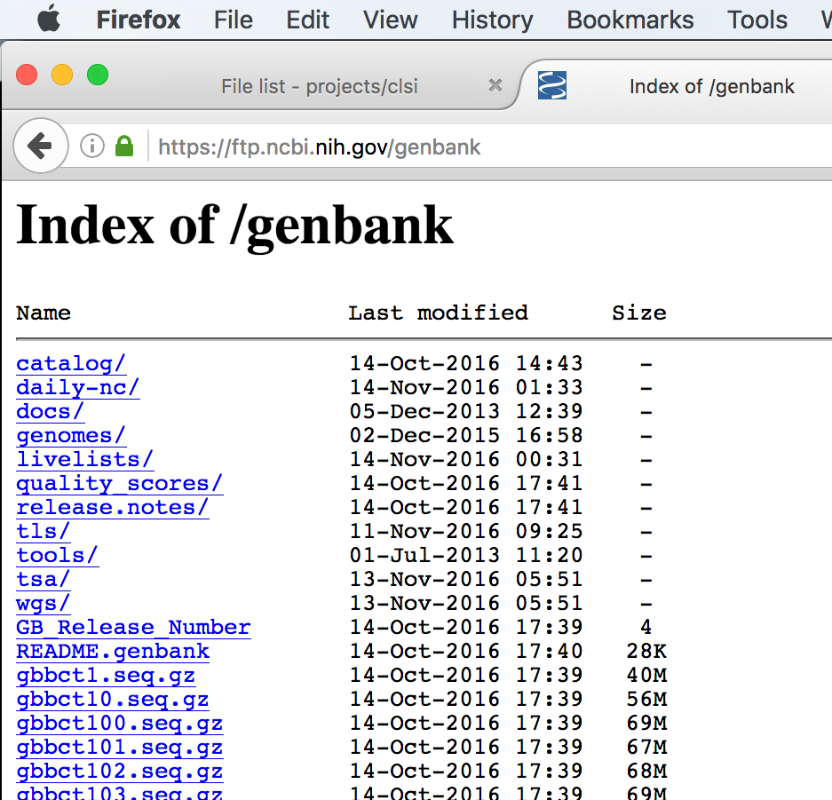
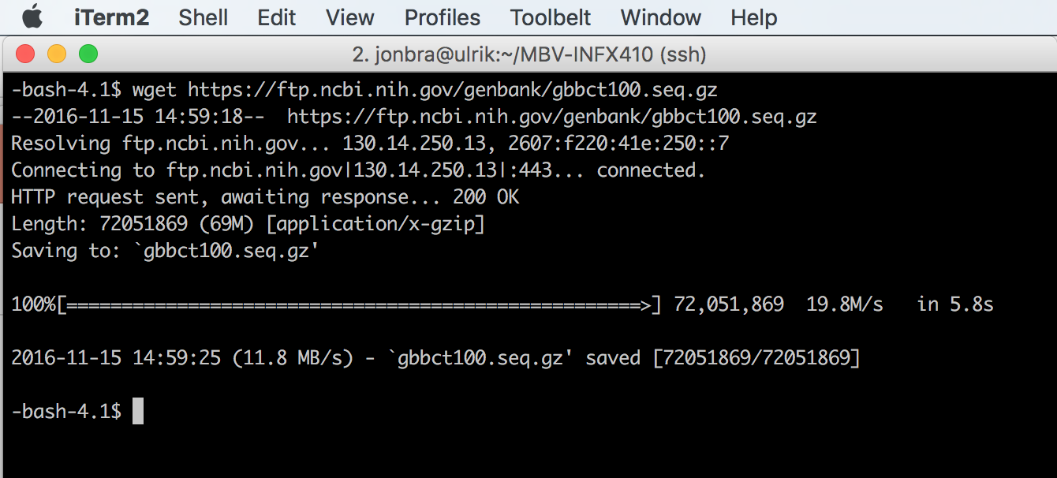
Downloading files from the internet
The wget command make it possible to download files from the web
Right-click and copy the link!

Slide 57
Redirect and pipe
Since Linux (and UNIX) use streams of text it is easy to
write the output of a command to a file.
Two versions:
The greater than symbol (>) is used to write a new files (will overwrite)
ls -lh > list_of_files.txt
Two symbols (>>) will append the content to a file
ls -lh >> list_of_files.txt

Slide 58
Redirect and pipe
Since Linux (and UNIX) use streams of text it is easy to
Use the output of one command as input in another with the horizontal line called pipe |
wc -l *fasta | sort -n
First command
Pipe
Second command

Slide 59
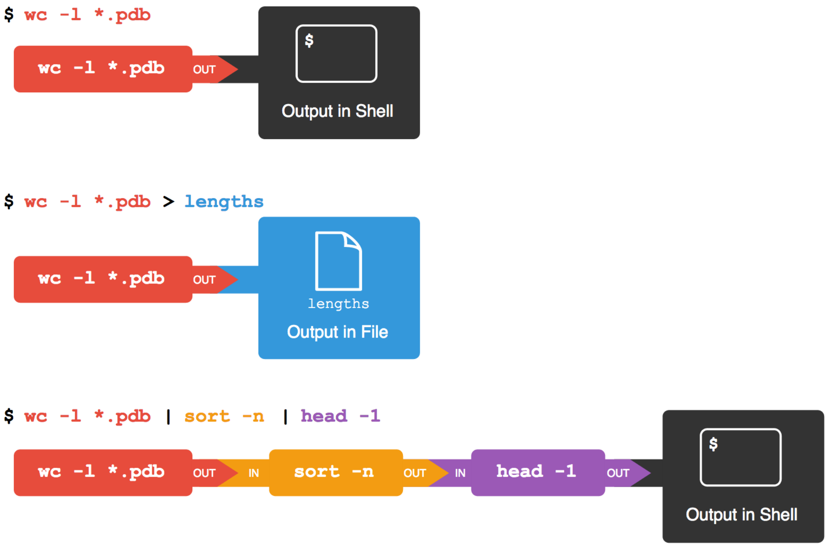

Slide 60
Many of the commands takes extra arguments
* = a wildcard!
ls –lh start_of_filena*
cd (home) ; cd dir (go to dir); cd .. (one level up, to the parent directory); cd ../../ (two levels up)
mv old_name new_name
mv /old/location/for/my/file /new/location/for/my/file
cp /path/to/file/to/copy/file /new/location/of/file
cp –r /dir/to/copy/dir /location/for/dir/copy
rm file
rm –rf /remove/directory/and/all/contents (use carefully!)
cat file1 file2 > newcatfile
paste file1 file2 > newpastefile
chmod a+x executablefile
chmod 755 file (owner:group:world permissions)

Slide 61
A few other very useful commands:
tail –n 300 file
(see last 300 lines file)
head –n 300 file
(see the first 300 lines of a file)
grep pattern file
(search pattern in file)
grep –c pattern file
(count pattern in file)
grep -f file_with_pattern file
(look up patterns from one file in another)
ssh user@machine
(remote connection)
Execute a program locally
./executable

Slide 62
It is possible to combine commands with a “pipe” |
output | input
ls | grep –c pattern (count patterns in filenames)
ls | grep pattern > file
Send output to file with “>”
grep pattern file > file2
Cut characters from a file
File1 (tab separated):
This is a test 1
This is a test 2
This is a test 3
Cut -f 1 file1
This
This
This

Slide 63
Loops
Assuming a directory with:
file1, file2,…, filen
We want to run a function over all files, then
for i in $(ls file*); do cut –f 2 $i > $i.out; done
(cuts the field 2 of each file and sends it to an output)
Execute functions in bashscripts
Open a new file and edit it in vim, nano or emacs. Call it bashscript.sh
#!/bin/bash
for i in $(ls file*); do cut –f 2 $i > $i.out; done
for i in $(ls *out); do wc $i > $i.wc: done
Make it executable:
chmod a+x bashscript.sh
./bashscript.sh (execute)

Slide 64
Piping commands together
Several commands in a row:
wc -l * | sort -n | head -n 3 > results.txt
More on this in Exercise 3.
https://github.com/krabberod/bios3010-unix-linux

Slide 65
Some online resources
Linux Cheat Sheet
https://www.cheatography.com/davechild/cheat-sheets/linux-command-line/
https://files.fosswire.com/2007/08/fwunixref.pdf
Vim Cheat Sheet
https://www.cheatography.com/nuggles/cheat-sheets/vim/
Nano Cheat Sheet
https://www.cheatography.com/bipinthite/cheat-sheets/nano-editor/

Slide 66
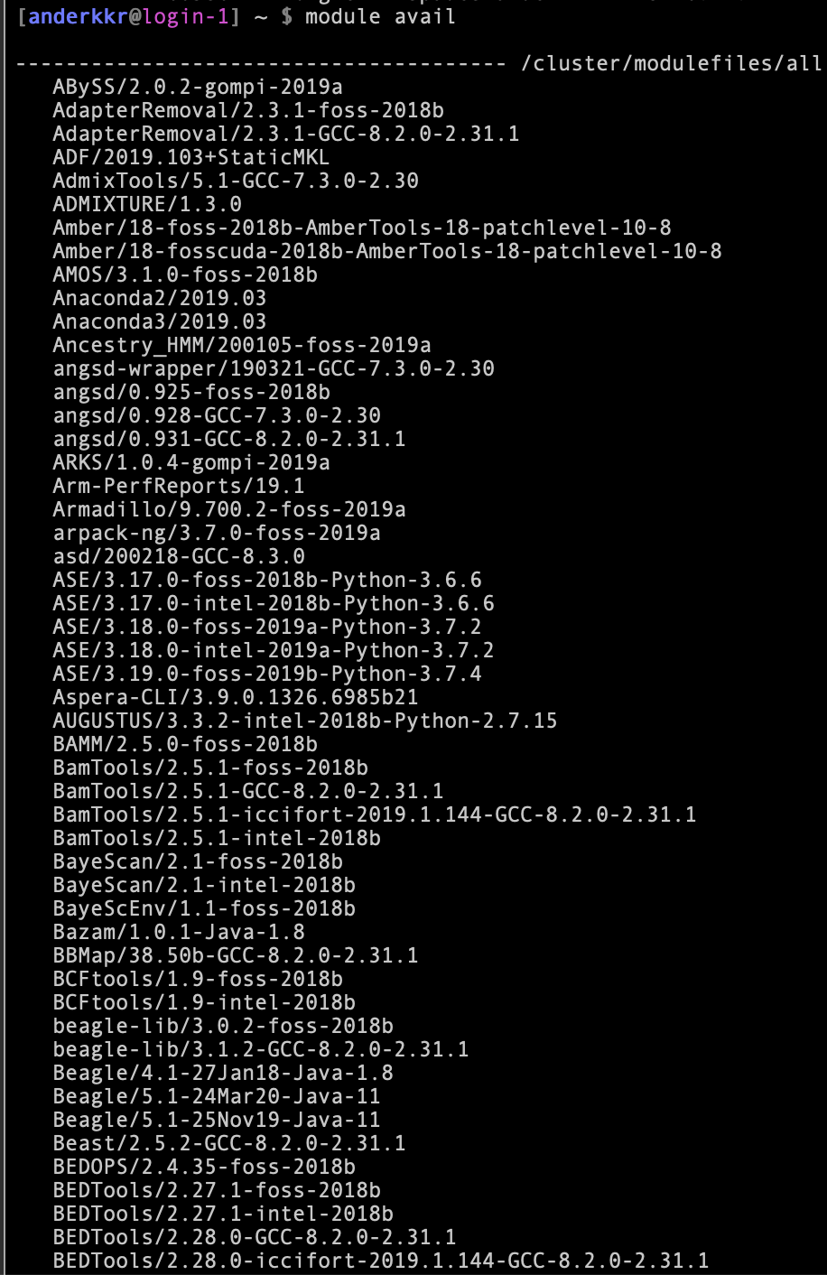
Preinstalled programs on Saga
Saga has already many preinstalled programs.
Check available modules with
module avail
These can be loaded by the command
module load <program>

Slide 67
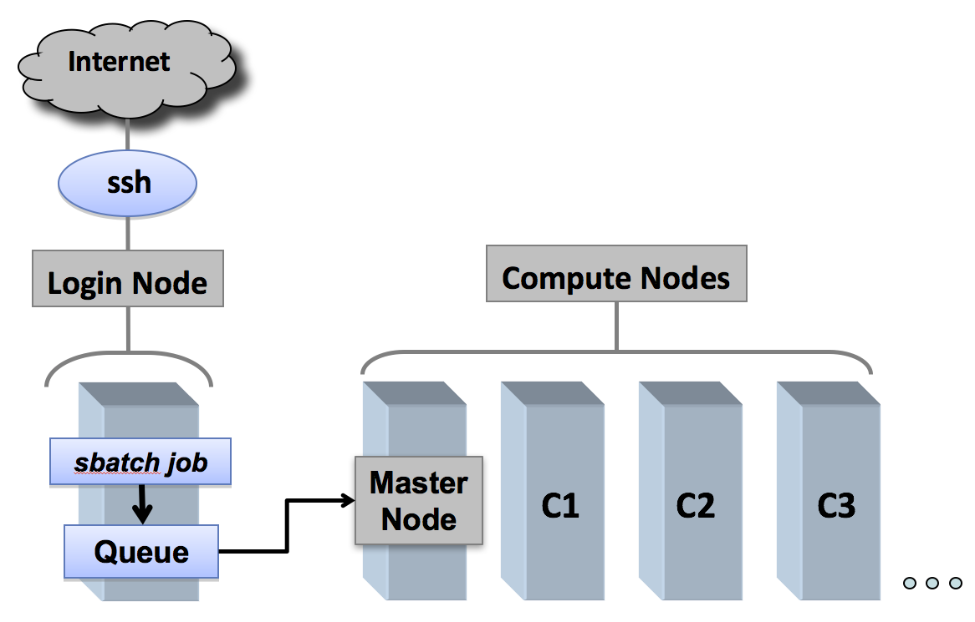
Queue system - Slurm
Since Saga is used by hundreds of people it needs a queueing system to divide the resources
The queue system is called Slurm.

Slide 68
Queue system - Slurm
Since Saga is used by hundreds of people it needs a queueing system to divide the resources
The queue system is called Slurm.
You are here

Slide 69
Queue system - Slurm
Since Saga is used by hundreds of people it needs a queueing system to divide the resources
The queue system is called Slurm.
You are here

Slide 70
Queue system - Slurm
You will use the queue system later in the course, when you will do genome assembly.

Slide 71
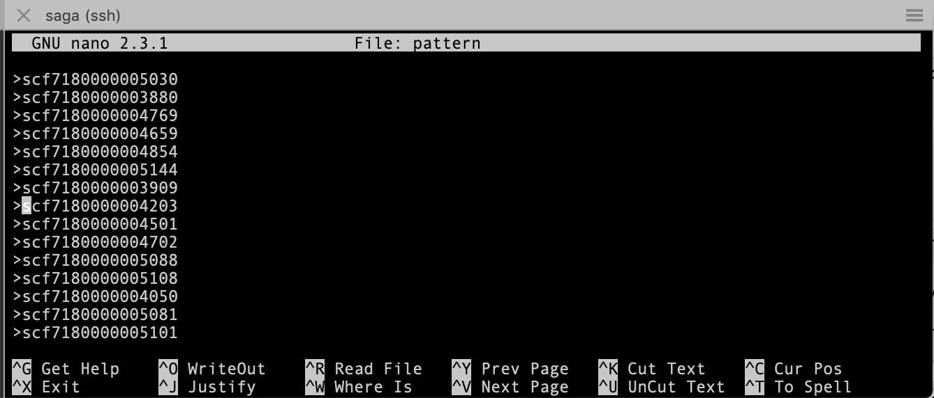
Text editors in Linux
Unix has many built-in ways editing text files.
We will be using nano in this course and it will be introduced in the exercises.
It is a very simple texteditor with simple, basic functionality.
Start:
nano filename
CTRL-x – Exits the editor. If you are in the middle of editing a file the exit process will ask you if you want to save your work.
CTRL-o – Save file name and continue working.
CTRL-w – Search your text.
CTRL-g – Get help with Nano.

Slide 72
Overwhelmed?
Keep calm and practice the simple stuff.
Test on real cases
Do the exercises:
https://github.com/krabberod/bios3010-unix-linux

